Slide 1

Cocktail Cafe Coffee shop environment serving classic cafe drinks and alcoholic indulgences.

Slide 2
Business Questions - Objective
What are Cocktail Café's best-selling menu items and what quantity of supplies are needed?
Maximize profits
Increase efficiencies
Support demand
Which are the busiest stores and is staffing optimal?
Do any adjustments need to be made to support peak-hours?
Are stores maximizing hours and labor efficiently?
Which menu items require the highest cost of supplies and could be removed from the menu? Would a membership program increase visit per customer?
Are any pricy drinks not performing well and can be removed?
Maximize profits on strong performing items

Slide 3
Business Questions – DM/DW Process and Lessons Learned
Data Warehouse
Data Mart
Visio Studio
Bulk Load Data
We considered our business questions to accurately build our Data Mart.

Slide 4
Problem Occurred
Linking Table
Small Data Type
Data Type Issue
Delete In Reverse Order
Slowly Changing Dimension

Slide 5
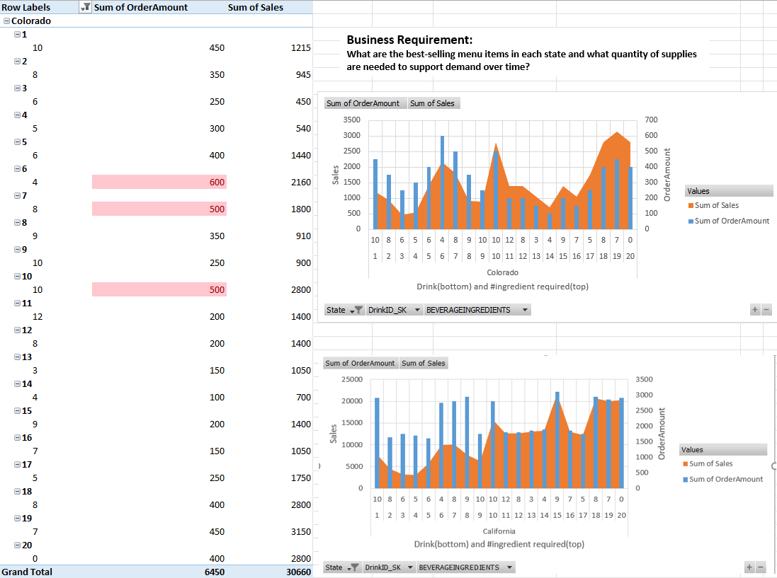
Business Requirement: What are the best-selling menu items in each state and what quantity of supplies
are needed to support demand over time?

Slide 6
Power Pivot Dashboard I.
Analysis:
Looking at the graph on the left, we can see how many of each drink is ordered, how much revenue that drink brings in, and the sum of all sales for that drink. In some cases, the sum of order amount does not equal a higher sum of sales. For example, drink 20 only had an amount of $400 but brought in the highest volume of sales.
By comparing this information to the two graphs, we can see this information relayed again while also showing how many ingredients those corresponding drinks each need. In Colorado, drink 6, 7, and 10 are three top selling items. Drink 6 requires 4 ingredients. Drink 7 requires 8 ingredients. Drink 10 requires 10 ingredients. Among the 3 drinks, their profits are similar. In California, Drink 8, 15, and 18 are three top selling items. Drink 8 and 15 both require 9 Ingredients and drink 18 requires 8 ingredients.
Business Recommendations:
From looking at the information in these three graphs, we can see that drinks 7,8,and 10 in Colorado all bring in similar profits and are equally ordered. The ingredients needed to make these three drinks should be always kept on hand. We can also recommend possibly cutting out a drink that requires a lot of ingredients and but does not bring in much profit; for example, drink 15 uses 9 ingredients and brings in a low amount of sales in Colorado.
Conversely, in California, we can recommend these stores always stock ingredients for drink 15 since it brings in much higher sales that in Colorado. This drink may be iced and much more popular in the warmer California weather than in cold Colorado. We would also recommend California stores cut drink 2 from their menus since it requires 8 ingredients and doesn't bring in enough sales to remain on the menu. By removing drinks each year and offering new ones, both States' stores can continue to bring in customers looking for something 'new' and get existing customers to find a new favorite, as well.

Slide 7
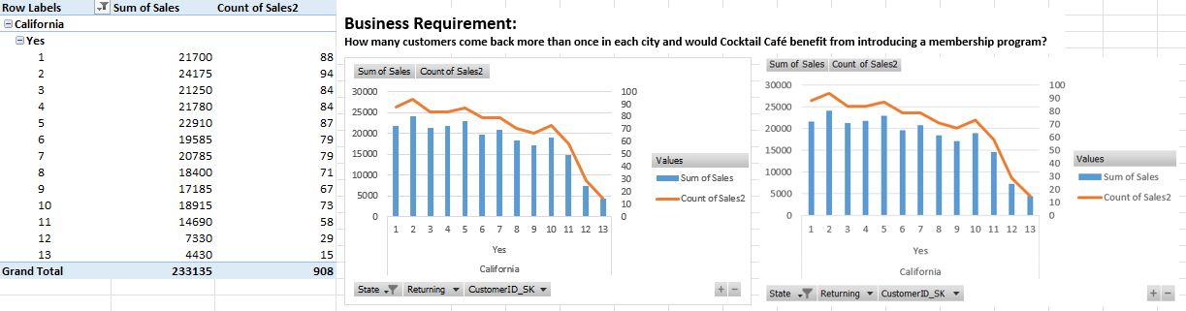
Business Requirement:
How many customers come back more than once in each city and would Cocktail Café benefit from introducing a membership program?

Slide 8
Power Pivot Dashboard II.
Analysis:
From all three graphs, we can see that over time, clients gradually stop frequenting Cocktail Cafe's establishments in both California and Colorado. If trends continue
this way without a change being made, business will suffer. We can see that sales stay strong, and even increase, after a customer's first visit. Visits increase around
the second and fifth visit, and then slowly decline after this. In Colorado, all the customers are returning customers. There are 5 customers who have already visited
CocktailCafe for more than 10 times. In California, all the customers are returning customers. Most of the returning members has visited CocktailCafe for more than 70 times.
Business Recommendation:
Based on this analysis, it is necessary to implement a membership program in California and consider implementing a different membership program in Colorado. Given the
trends of drinks purchased in California compared to Colorado, we can predict the same membership program will not work the same in both states. The level or visit at which they receive perks should differ to incentivize customers to come back again and again. However, given Colorado's sales are stronger during customer's first visits, opening more locations may produce more sales than a membership program.

Slide 9
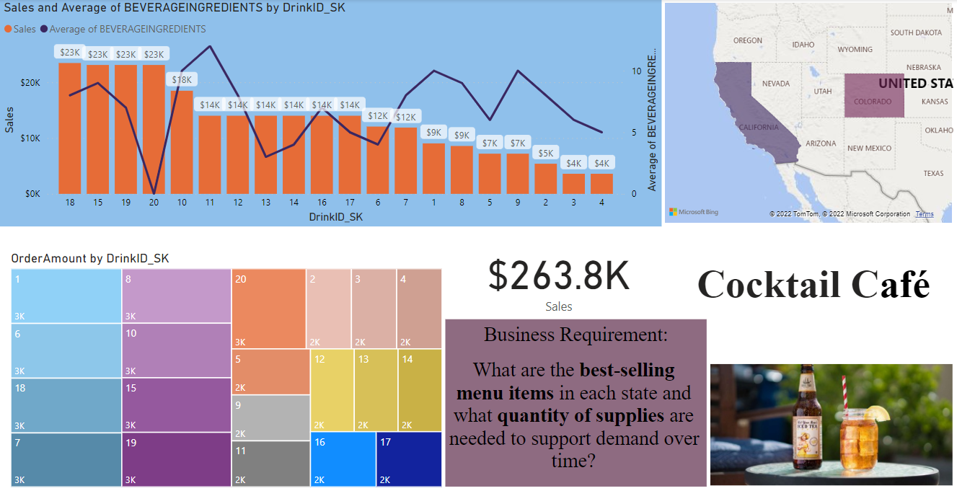

Slide 10
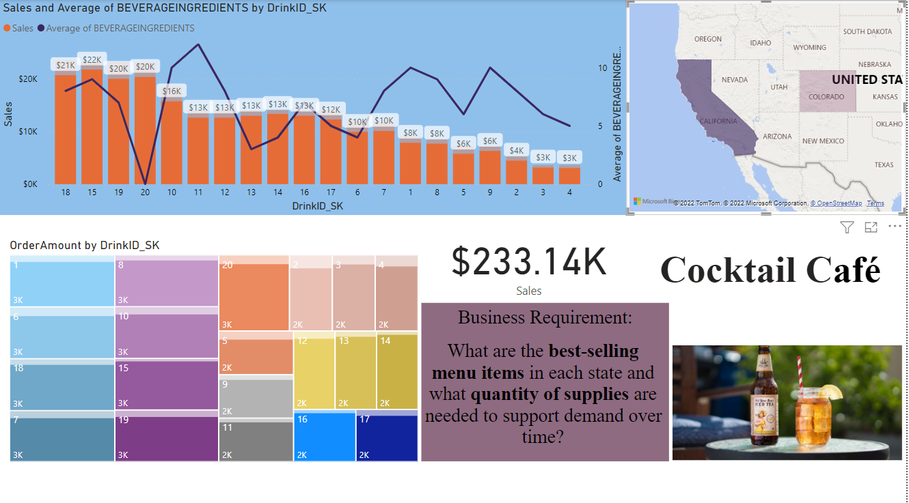

Slide 11
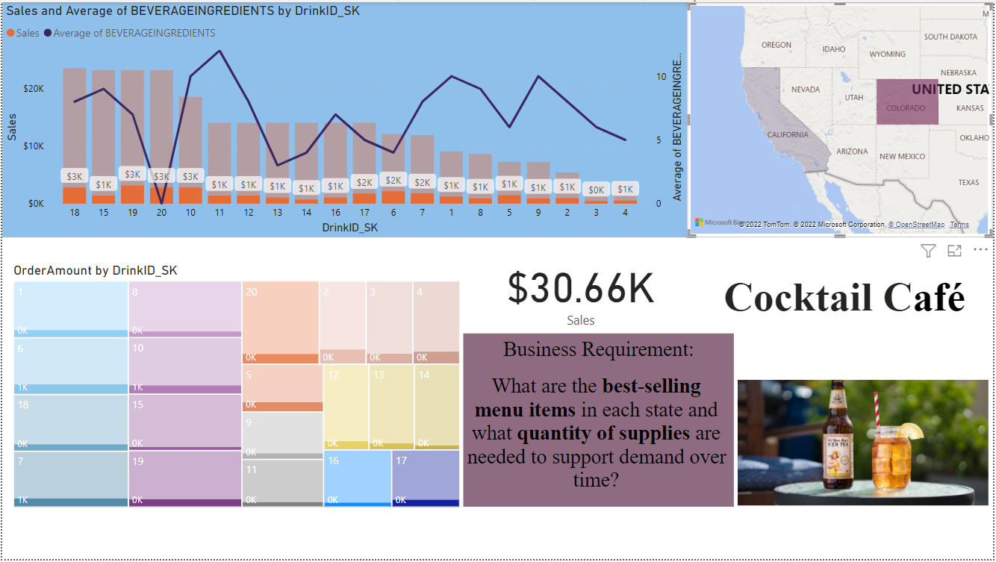

Slide 12
Power BI Dashboard I.
Analysis
Given we have stores in two states, we consider the sales and ingredients used in each location. From the large graph, there is some value in the ingredients used in that some bring in higher sales than others that do not. From the graph, drinks 18, 19, and 29 bring in the most profits and do not require as many ingredients. Some drinks use many ingredients and do not bring in a lot of profits. Drink 20 is the top performer because it does not require any additional ingredients and brings in quite a bit of sales.
Business Recommendation
From the analysis, the recommended course of action would be to remove the drinks that use the most amount of ingredients and bring in the least number of sales. By doing so, the cafes can either introduce new drinks that may be appealing to current customers, or they can choose to continue operating under their current offerings and increase profits selling those they know have a history of performing well.

Slide 13
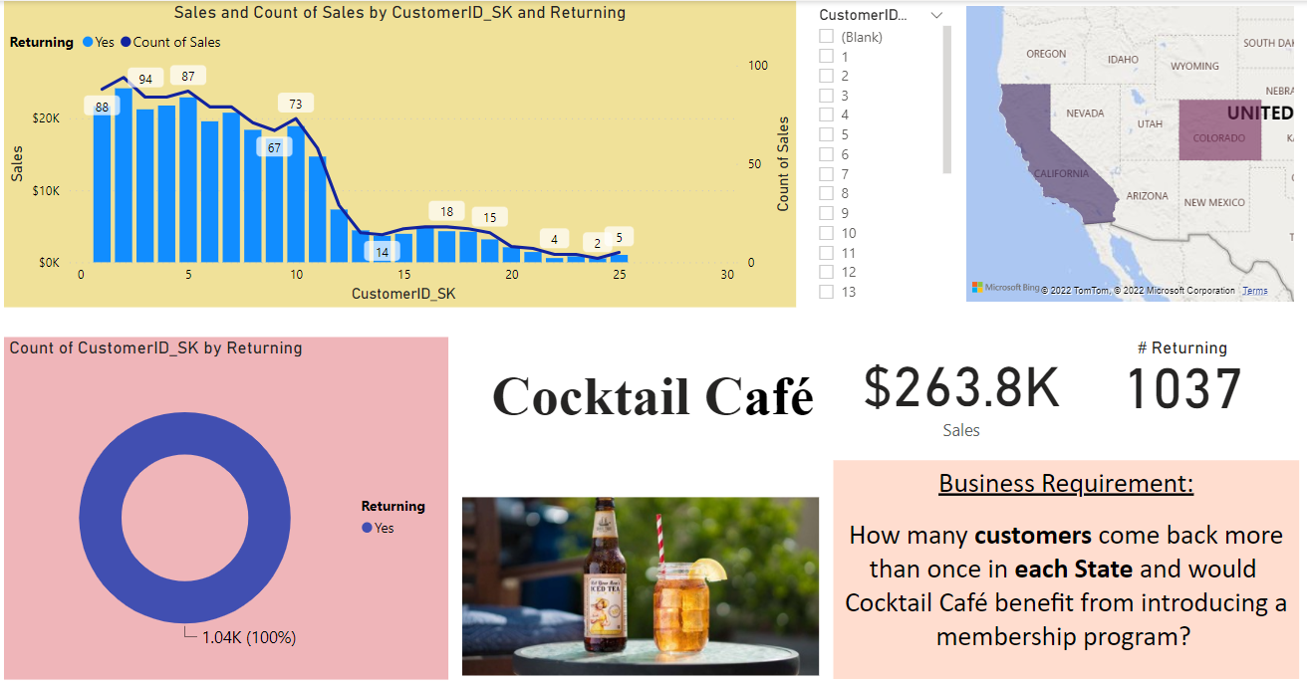

Slide 14
Power BI Dashboard II.
Analysis
Seeing the number of sales from the returning customers gives us a basis for considering a membership program. We can see the number of repeating sales by customer and know how many times they visit and how much they have spent at our cafes. Our original customers are those who repeat the most times and spend the most money. Looking at customers one through 10 visit over and over. As new customers try our establishment, however, we see the amount of sales dip significantly.
We can also see that so far; all our customers do return at least once (circle chart) and the resulting sales from those customers.
Business Recommendation
Based on the decline in new customers returning more than a few times, introducing a membership program with various rewards would increase the number of visits each individual customer visits a cafe and would also increase spend over the course of their visits. We might want to implement a first-time discount, a recurring weekly reward for those who visit on our slowest profit days. We could also offer birthday treats and consider a free drink per every 10 visits. In order to maximize profits, the membership programs and rewards will differ by region and will maximize how these customers visit in each state, and city.

